Slide 1
Chapter 2 Analysis of Algorithms Efficiency

Slide 2
Concept Covers in this Chapter
The Analysis Framework
Asymptotic Notations and Basic Efficiency Classes
Mathematical Analysis of Nonrecursive Algorithms
Mathematical Analysis of Recursive Algorithms

Slide 3
The Analysis Framework
There are two kinds of efficiency:
Time efficiency and Space efficiency.
Time efficiency, also called time complexity, indicates how fast an algorithm in question runs.
Space efficiency, also called space complexity, refers to the amount of memory units required by the algorithm in addition to the space needed for its input and output.
Note: The research experience has shown that for most problems, we can achieve much more spectacular progress in speed than in space.

Slide 4
Asymptotic Notations
Θ, O, Ω, o, ω
Theta, Big-Oh, Big-Omega/Omega, small/little oh, small/little omega.
Used for comparing two functions say f(n) and g(n).
Need this notation for analysis of algorithm – i.e., to analyze time complexity/space complexity of an algorithm as a function of input size n say f(n). n is positive integer and f(n) is monotonically increasing function (in the case of time and space complexity).

Slide 5
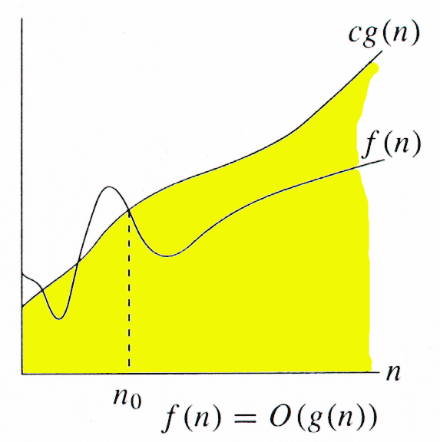
Big-Oh (O)
f(n)=O(g(n)) iff ∃ positive constants c and n_{0,} such that ∀n ≥ n₀,
such that f(n) ≤ cg(n)
g(n) is an asymptotic upper bound for f(n).

Slide 6
Examples
Any linear function an + b is in O(n²). How?
an + b ≤ |a| n² +|b| n² for all n ≥ 1
= (|a|+|b|) n² = O(n²)
Another way:
an + b ≤ an² + n² for all n ≥ max{|a|, |b|}
= (a+1)n² = O(n²)
Whether an+b=O(n) ?
Yes.
an + b ≤ |a|n + n for all n ≥ b
= (|a|+1) n
Taking c = (|a|+1) and n_{o}=b we get an+b=O(n)
an + b <= c n <= cn^2 <= cn^3 … etc.

Slide 7
Example 1:
3n + 5 is O(n²). How?
f(n)=3n + 5 and g(n)=(n²)
Ist Method:
Take f(n)=3n + 5
Replace n by n²
3n + 5 ≤ 3 n² +5 n²
3n + 5 ≤ 8 n²
c=8 and no=1 such that n>=1

Slide 8
Examples 1:
3n + 5 is O(n²). How?
f(n)=3n + 5 and g(n)=(n²)
IInd Method:
Take f(n)=3n + 5
Add n²
3n + 5 ≤ 3 n² + n²
3n + 5 ≤ 4 n²
c=4 and no=2 such that n>=2

Slide 9
Example 2:
3n + 5 is O(n). How?
f(n)=3n + 5 and g(n)=(n)
Ist Method:
Take f(n)=3n + 5
Replace by n
3n + 5 ≤ 3 n+5 n
3n + 5 ≤ 8 n
c=8 and no=1 such that n>=1

Slide 10
Examples 2:
3n + 5 is O(n). How?
f(n)=3n + 5 and g(n)=(n)
IInd Method:
Take f(n)=3n + 5
Add n
3n + 5 ≤ 3 n + n
3n + 5 ≤ 4 n
c=4 and no=5 such that n>=5

Slide 11
Example 3:
3n + 2 is O(n). How?
f(n)=3n + 2 and g(n)=(n)
Ist Method:
Take f(n)=3n + 2
Replace by n
3n + 2 ≤ 3 n+2n
3n + 2 ≤ 5n
c=5 and no=1 such that n>=1

Slide 12
Examples 2:
3n + 2 is O(n). How?
f(n)=3n + 2 and g(n)=(n)
IInd Method:
Take f(n)=3n + 2
Add n
3n + 2 ≤ 3 n + n
3n + 2 ≤ 4 n
c=4 and no=2 such that n>=2

Slide 13
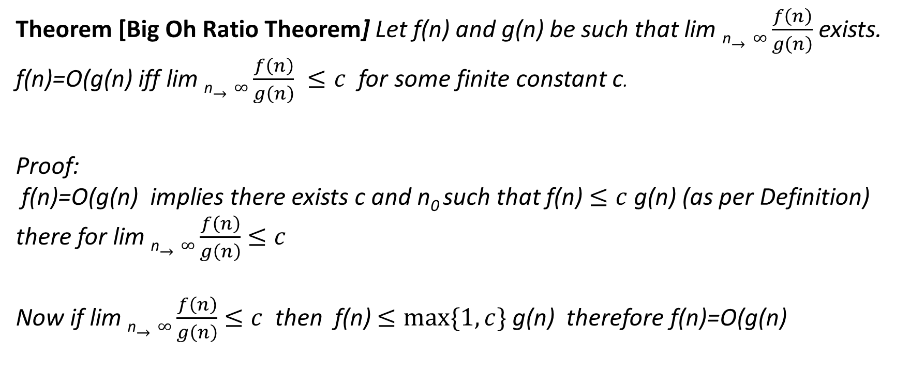
Big Oh Ratio Theorem
Theorem [Big Oh Ratio Theorem] Let f(n) and g(n) be such that lim _{n}$→∞\frac{f\left(n\right)}{g\left(n\right)}$ exists. f(n)=O(g(n) iff lim _{n}$→∞\frac{f\left(n\right)}{g\left(n\right)} ≤c$for some finite constant c.
Proof:
f(n)=O(g(n) implies there exists c and n₀ such that f(n) $≤c$g(n) (as per Definition) there for lim _{n}$→∞\frac{f\left(n\right)}{g\left(n\right)}$ $≤c$
Now if lim _{n}$→∞\frac{f\left(n\right)}{g\left(n\right)}$ $≤c$ then f(n) $≤max⁡\{1, c\}$g(n) therefore f(n)=O(g(n)

Slide 14
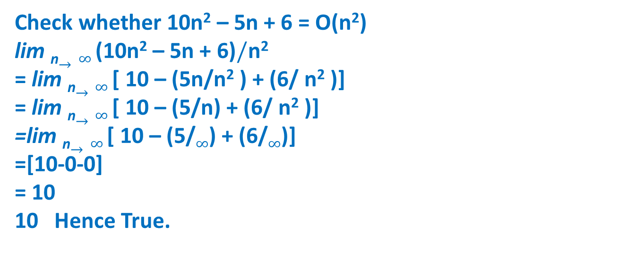
Big Oh Ratio Theorem
Check whether 10n² – 5n + 6 = O(n²)
lim _{n}$→∞ \text{(1}\text{0}\text{n}\text{2}\text{ – 5}\text{n}\text{ + 6)}/\text{n}\text{2}$
= lim _{n}$→∞$[ 10 – (5n/$\text{n}\text{2}$ ) + (6/ $\text{n}\text{2}$ )]
= lim _{n}$→∞$[ 10 – (5/$\text{n}$) + (6/ $\text{n}\text{2}$ )]
=lim _{n}$→∞$[ 10 – (5/$∞$) + (6/$∞$)]
=[10-0-0]
= 10
10 Hence True.

Slide 15
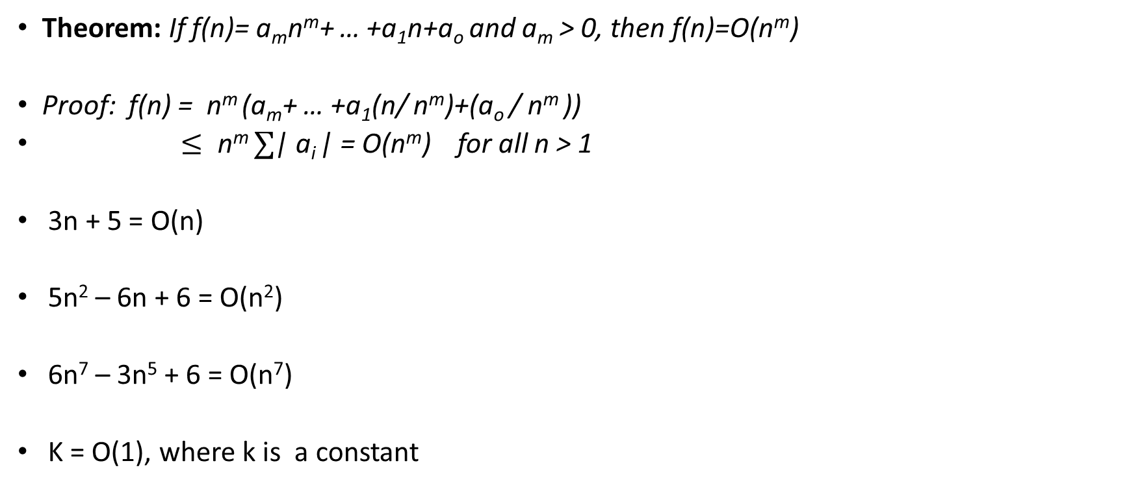
Theorem: If f(n)= a_{m}n^{m}+ … +a₁n+a_{o} and a_{m} > 0, then f(n)=O(n^{m})
Proof: f(n) = n^{m} (a_{m}+ … +a₁(n/ n^{m})+(a_{o} / n^{m} ))
$≤ \text{n}\text{m} ∑$| a_{i} | = O(n^{m}) for all n > 1
3n + 5 = O(n)
5n² – 6n + 6 = O(n²)
6n⁷ – 3n⁵ + 6 = O(n⁷)
K = O(1), where k is a constant

Slide 16
Solve the following:
d) lim _{n}$→∞\frac{15n3 logn+16n2 }{n3}$ = lim _{n}$→∞$ $\frac{15n3 logn }{n3}$ + $\frac{16n2 }{n3}$ = $∞$

Slide 18
Show that p(n) is asymptotically bigger than q(n)
f(n) =O(g(n)) iff f(n) <= c g(n) g(n) is asymptotically bigger than f(n)
Lim n-> inf q(n)/p(n) = lim n-> inf (100 n2^n + 33 n)/(17n^2 2^n) = lim n-> inf 100/n + 33/17n2^n = 0
Using Big Oh Ratio theorem
q(n)=O(p(n))

Slide 19
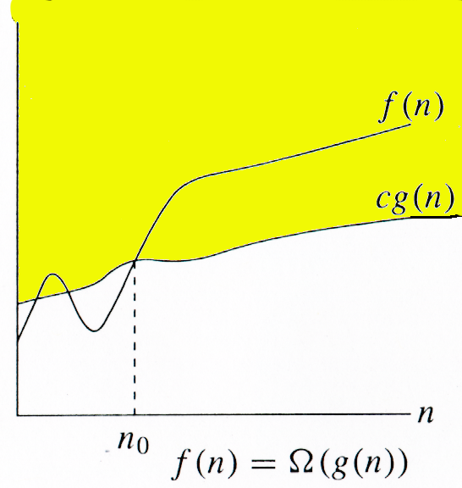
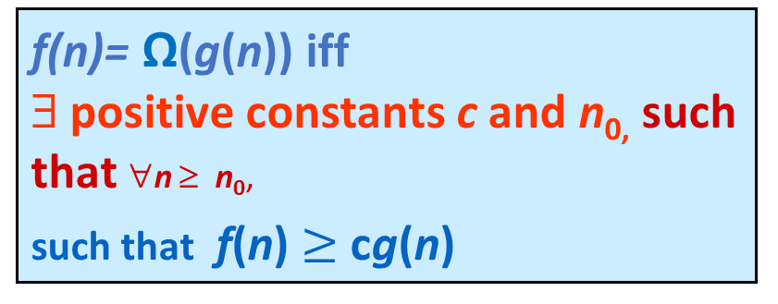
Omega Notation (Ω)
f(n)= Ω(g(n)) iff ∃ positive constants c and n_{0,} such that ∀n ≥ n₀,
such that f(n) $≥$ cg(n)
g(n) is an asymptotic lower bound for f(n).

Slide 20
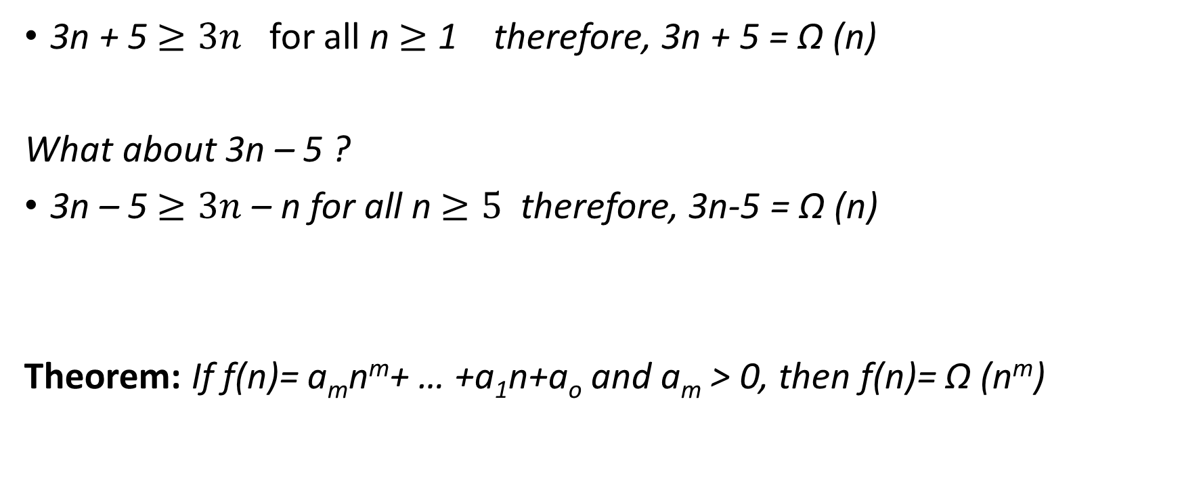
Examples
3n + 5 $≥3n$ for all n $≥$ 1 therefore, 3n + 5 = Ω (n)
What about 3n – 5 ?
3n – 5 $≥3n$– n for all n $≥5$therefore, 3n-5 = Ω (n)
Theorem: If f(n)= a_{m}n^{m}+ … +a₁n+a_{o} and a_{m} > 0, then f(n)= Ω (n^{m})

Slide 21
Big Omega (Ω) notation provides a lower bound for a function. Mathematically:
f(n)=Ω(g(n))if there exist constants c>0 and n0≥1such that f(n)≥c⋅g(n) ∀n≥n0.
In this case:
f(n)=3n−5
g(n)=n
We want to prove that 3n−5≥c⋅n for some constant c>0 and sufficiently large n.

Slide 22
Step 1: Choose a form for the inequality
We need to check when:
3n−5≥c⋅n
the inequality:
3n−5≥c⋅n
3n−c⋅n≥5
(3−c)⋅n≥5
n≥5/(3−c)​

Slide 23
Step 2: Choosing a constant c
To find a valid constant c such that this holds for sufficiently large n:
If we pick c=2, then the inequality becomes:
n≥5/(3−2)=5.
Thus, for n≥5,3n−5≥2n.
Conclusion
We have shown that:
f(n)=3n−5≥2 for all n≥5.
Therefore, 3n−5=Ω(n) with c=2 and n0=5.

Slide 24
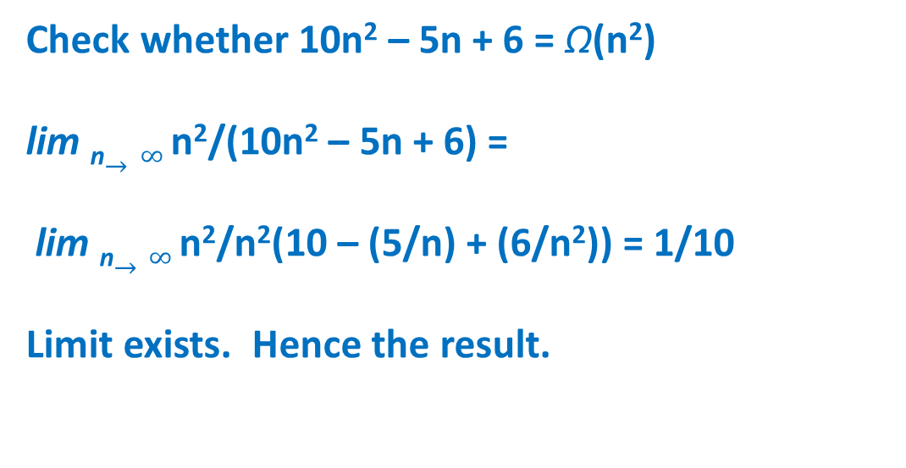
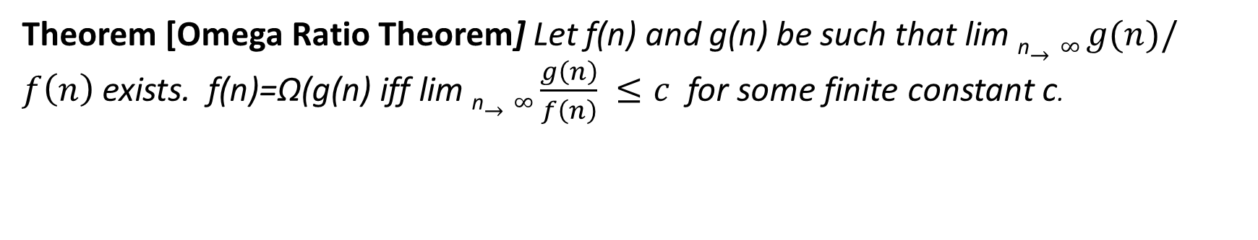
Omega Ratio Theorem
Theorem [Omega Ratio Theorem] Let f(n) and g(n) be such that lim _{n}$→∞ g(n)/f\left(n\right)$ exists. f(n)=Ω(g(n) iff lim _{n}$→∞\frac{g\left(n\right)}{f\left(n\right)} ≤c$for some finite constant c.
Check whether 10n² – 5n + 6 = Ω(n²)
lim _{n}$→∞ \text{n}\text{2}\text{/(1}\text{0}\text{n}\text{2}\text{ – 5}\text{n}\text{ + 6)}$ =
lim _{n}$→∞ \text{n}\text{2}\text{/}\text{n}\text{2}\text{(1}\text{0} \text{– }\text{(}\text{5}\text{/}\text{n}\text{)}\text{ + }\text{(}\text{6}\text{/}\text{n}\text{2}\text{)}\text{) = 1/10}$
Limit exists. Hence the result.

Slide 25
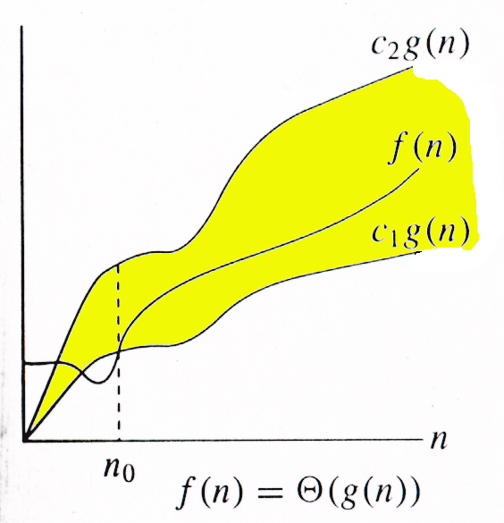
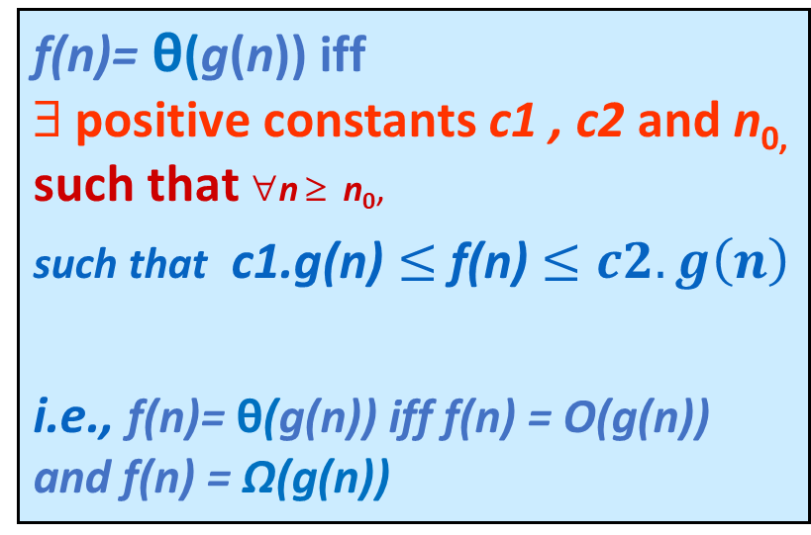
Theta Notation (θ)
f(n)= θ(g(n)) iff ∃ positive constants c1 , c2 and n_{0,} such that ∀n ≥ n₀,
such that c1.g(n) $≤$f(n) $≤c2.g\left(n\right)$
i.e., f(n)= θ(g(n)) iff f(n) = O(g(n)) and f(n) = Ω(g(n))
g(n) is an asymptotic lower and upper bound for f(n).

Slide 26
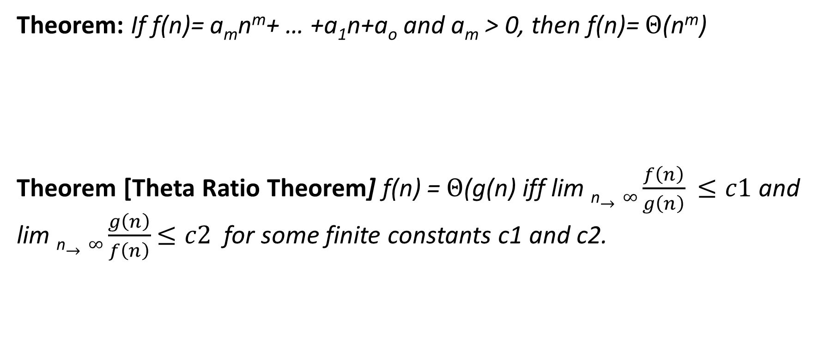
Theorem: If f(n)= a_{m}n^{m}+ … +a₁n+a_{o} and a_{m} > 0, then f(n)= $Θ$(n^{m})
Theorem [Theta Ratio Theorem] f(n) = $Θ$(g(n) iff lim _{n}$→∞\frac{f\left(n\right)}{g\left(n\right)}$ $≤c1$ and lim _{n}$→∞\frac{g\left(n\right)}{f\left(n\right)}$ $≤c2$for some finite constants c1 and c2.

Slide 27
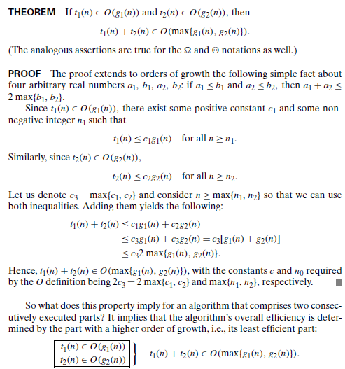

Slide 28

Small Oh (o)
f(n) = o(g(n)) iff f(n)=O(g(n)) but f(n) ≠ Ω (g(n))
i.e., lim _{n}$→∞\frac{f\left(n\right)}{g\left(n\right)}$ = 0
Example 3n + 5 = o (n²) = o(n³)

Slide 29

Small Omega (ω)
f(n) = ω(g(n)) iff f(n)= Ω (g(n)) but f(n) ≠ O (g(n))
i.e., lim _{n}$→∞\frac{g\left(n\right)}{f\left(n\right)}$ = 0

Slide 30
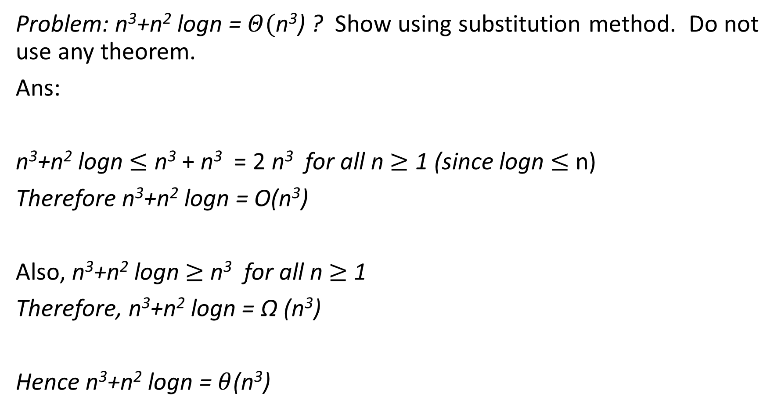
Problem: n³+n² logn = $Θ(\text{n}\text{3}$) ? Show using substitution method. Do not use any theorem.
Ans:
n³+n² logn $≤$ n³ + n³ = 2 n³ for all n $≥$ 1 (since logn $≤$ n)
Therefore n³+n² logn = O(n³)
Also, n³+n² logn $≥$ n³ for all n $≥$ 1
Therefore, n³+n² logn = Ω (n³)
Hence n³+n² logn = $θ$(n³)

Slide 31
Space and Time Complexity
To analyze an algorithm means:
developing a formula for predicting how fast an algorithm is, based on the size of the input (time complexity),
and/or
developing a formula for predicting how much memory an algorithm requires, based on the size of the input (space complexity).
Usually, time is our biggest concern
Most algorithms require a fixed amount of space

Slide 32
Measuring an Input Size
Almost all algorithms run longer on larger inputs
Eg: 1) sort larger arrays 2) Multiply larger matrices
It is logical to investigate an algorithm’s efficiency as a function of some parameter n indicating the algorithm’s input size

Slide 33
Size of the input ?
Problem | Size of the Input
Searching an element in an array of size n | n
Sorting n elements | n
Merging two arrays | Sum of size of two array
Adding two matrices of order m x n | m and n
Multiplying two matrices or order m x n and n x p | m, n and p

Slide 34
Space Complexity
Depends on
Data Space:
Space needed by the constants and simple variables
Space needed by dynamically allocated objects
Environmental Stack Space: used to save information needed to resume execution of partially completed methods and functions.
Example: if function f() invokes function g(), then we must save at least a pointer to the instruction of f() to be executed when g() terminates.
Instruction Space: Space needed to store the compiled version of the program instruction
Compiler Dependent

Slide 35
Space Complexity Contd…
The space requirement of any program P can be written as:
S = C + S_{p}(size of the input), where c denotes fixed part and S_{p} denotes the variable component
We are interested in Variable Component.

Slide 36
In C++ data size

Slide 37
Space Complexity Example: Sequential or Linear Search
Int SequentialSearch(int a[], int n, const int& x) a[0] a[1] ….a[n-1]
{
int i;
for (i = 0; i < n && a[i] != x; i++);
if (i == n) return -1;
else return i;
}
Space needed by parameters a, n and x = 4 + 4 + 4 = 12 bytes (integer type)
Space needed by variable i = 4 bytes
Space needed by constants 0 and -1 = 4 + 4 = 8 bytes
Total Space needed = 24 bytes (Constant ) therefore, Sp(n)=0
Complexity = O(1)

Slide 38
Space Complexity Example: Recursive Sequential Search
Int RSequentialSearch(int a[], int n, const int& x)
{
if ( n < 1) return -1;
if (a[n-1] == x) return n-1;
return RSquentialSearch(a n-1, x);
}
Ignore the constant space needed and find Environmental stack space.
Environment Stack Space:
RSequentialSearch (a, n, x)
RsequentialSearch (a, n-1, x)
…..
……
RSequentialSearch(a, 1, x)
RSequentialSearch (a, 0, x)
Therefore, depth of recursion: n + 1
Each time for recursive calls, a, n, x and return address stored in stack. Since all are integers, 4 * 4 = 16 bytes needed.
Therefore, total environmental stack space = 16 (n+1) bytes= O(n).

Slide 39
Write a C++ function for finding sum of array elements. Write both iterative and recursive program and find its space complexity.
int sum (int a[], int n)
{
int result;
for(int i=0; i<n; i++)
result= result + a[i];
return result;
}
int Rsum (int a[], int n)
{
if (n > 0)
return Rsum(a, n-1) + a[n-1];
return 0;
}
Rsum(a, n) Rsum(a, n-1)….Rsum(a,1), Rsum(a, 0) therefore, depth= n+1
Sp(n) = 0 constant space O(1)
Sp(n) = 12 (n+1) bytes =O(n)

Slide 40
Data Space Examples
i. Int *a;
a = new int [n]; Space needed 4n Bytes (n integers, each need 4 Bytes)
ii. Int a[30]; 4 x 30 = 120 Bytes
iii. int **A;
A = new int * [m];
for(int i=0; i<m; i++)
A[i] = new int [n];
Space allotted for matrix A is 4mn bytes. O(mn) space complexity.

Slide 41
Tutorial (Solve and upload in class file section tutorial week1 folder)
1. Write a C++ function for maximum and minimum element in an array and find its space complexity. [Do not write full program with main() function. Only function code need to be written.]
2.
Show that p(n) is asymptotically bigger than q(n)
Show that

Slide 42
Time complexity
Operation Count Method
Step Count Method

Slide 43
Units for Measuring Running Time
Speed of the Computer
Quality of a program implementing the algorithm
Compiler used in generating the machine code
Number of Inputs

Slide 44
Units for Measuring Running Time
To identify the most important operation of the algorithm called the basic operation
The operation contributes the most to the total running time and computes the number of times the basic operation is executed.
It is not difficult to identify the basic operation of an algorithm
It is usually the most time-consuming operation in the algorithmic innermost loop

Slide 45
Basic Operations
Comparison e.g.: Searching
Addition
Subtraction
Multiplication
Division – most time consuming

Slide 46
Running time of a Program
T(n) = C_{op}C(n)
Where
T(n) - running time of a program
c_{op} be the execution time of an algorithm’s basic operation on a particular computer
C(n) be the number of times this operation needs to be executed for this algorithm.

Slide 47
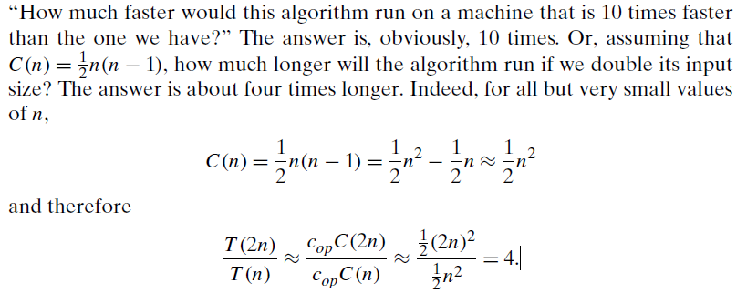

Slide 49
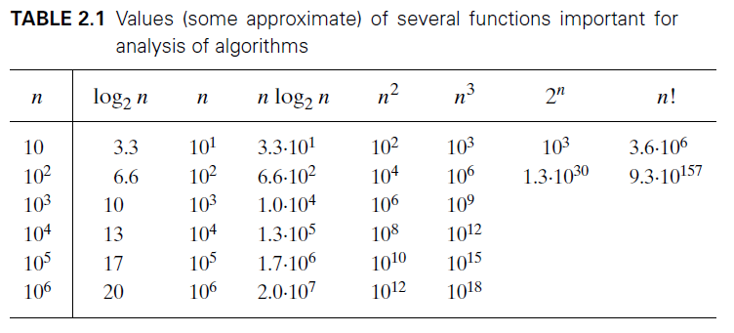
Order of Growth

Slide 50
Practical Complexities
10⁹ instructions/second

Slide 51
Impractical Complexities
10⁹ instructions/second

Slide 52
Faster Computer Vs Better Algorithm
Algorithmic improvement more useful
than hardware improvement.
E.g. 2^{n} to n³

Slide 53
Operation Count Method
Identify one or more key operations in the algorithm/program and count how many times each key operation is performed in the algorithm.
Examples
Matrix multiplication:
Key operations are addition and multiplications
Sorting:
Key operations are comparison and swapping.
Searching:
Comparison

Slide 54
Matrix Multiplication
void matrixMultiply(int **a, int **b, int **c, int m, int n, int p)
{
// Multiply the m x n matrix a and the n x p matrix b to get c.
for (int i = 0; i < m; i++)
for (int j = 0; j < p; j++)
{
int sum = 0;
for (int k = 0; k < n; k++)
sum += a[i][k] * b[k][j];
c[i][j] = sum;
}
}

Slide 55
Matrix Multiplication
void matrixMultiply(int **a, int **b, int **c, int m, int n, int p)
{
// Multiply the m x n matrix a and the n x p matrix b to get c.
for (int i = 0; i < m; i++)
for (int j = 0; j < p; j++)
{
int sum = 0;
for (int k = 0; k < n; k++)
sum += a[i][k] * b[k][j];
c[i][j] = sum;
}
}
Key operations are addition and multiplications
Additions mnp times
Multiplications mnp times
Complexity O(mnp)
Notes:
So, the total number of operations (additions and multiplications) performed by this algorithm is given by:
Operations = m * p * n

Slide 56
Polynomial Evaluation: p(x)=c_{n}x^{n}+ c_{n-1}x^{n-1} + . . . + c₁ x + c₀
double polyEval(double c[], int n, const double& x)
{// Evaluate the degree n polynomial with
// coefficients coeff[0:n] at the point x.
double y = 1, value = c[0];
for (int i = 1; i <= n; i++)
{// add in next term
y *= x;
value += y * c[i];
}
return value;
}

Slide 57
Polynomial Evaluation: p(x)=c_{n}x^{n}+ c_{n-1}x^{n-1} + . . . + c₁ x + c₀
double polyEval(double c[], int n, const double& x)
{// Evaluate the degree n polynomial with
// coefficients coeff[0:n] at the point x.
double y = 1, value = c[0];
for (int i = 1; i <= n; i++)
{// add in next term
y *= x;
value += y * c[i];
}
return value;
}
No. of additions = n
No. of Multiplications = 2n
Complexity = O(n)
4x^3 + 5x + 3
C3 = 4
C2=0
C1=5
C0=3

Slide 58
Rank of an Element in a Sequence
The rank of an element in a sequence is the number of smaller elements in the sequence plus the number of equal elements that appears to its left.
example: a = [4, 3, 9, 3, 7]
Rank r = [2, 0, 4, 1, 3]
Rank Sort: Sorting elements in an array based on their ranks

Slide 59
Rank of an Element in a Sequence
Key Operation: Comparison
Number of times a[j] <= a[i] occurs is
i=1 j takes the value 0
1 comparison
i=2 j takes the value 0, 1
2 comparison
….
i=n-1 j takes the value 0, 1, …, n-2
n-1 comparison
Total Comparisons = 1 + 2 + … + n-1= n (n – 1 )/2
= O(n²)
void rank(int a[], int n, int r[])
{// Rank the n elements a[0:n-1].
// Element ranks returned in r[0:n-1]
for (int i = 0; i < n; i++)
r[i] = 0; // initialize
// compare all element pairs
for (int i = 1; i < n; i++)
for (int j = 0; j < i; j++)
if (a[j] <= a[i]) r[i]++;
else r[j]++;
}

Slide 60
Rank Sort
void rearrange(T a[], int n, int r[])
{
int *u = new int [n]; // create additional array
// move to correct place in u
for (int i = 0; i < n; i++)
u[r[i]] = a[i];
// move back to a
for (i = 0; i < n; i++)
a[i] = u[i];
delete [] u;
}
Example: a = [4, 3, 9, 3, 7] Rank r = [2, 0, 4, 1, 3]
U[2]=4 , u[0]=3, u[4]=9, u[1]=3, u[3]=7
a = u = [3, 3, 4, 7, 9]
Finding Rank : O(n²)
Rearrangement takes O(n) time
Total Complexity of Rank Sort = O(n²)

Slide 61
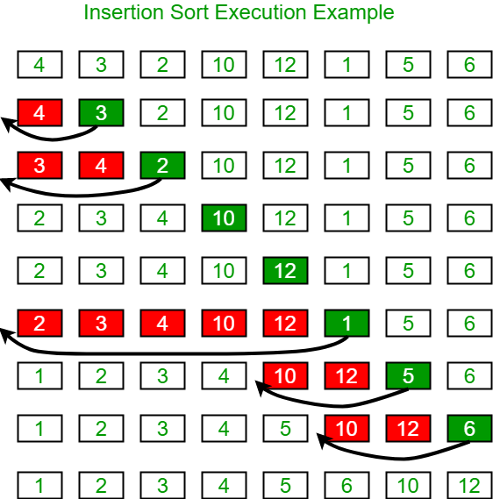
Insertion sort

Slide 62
Insertion Sort
void insertionSort(int a[], int n)
{
}

Slide 63
Insertion Sort
void insertionSort(int a[], int n)
{
for (int i = 1; i < n; i++)
{
}
}

Slide 64
Insertion Sort
void insertionSort(int a[], int n)
{
for (int i = 1; i < n; i++)
{
int t = a[i];
}
}

Slide 65
Insertion Sort
void insertionSort(int a[], int n)
{
for (int i = 1; i < n; i++)
{// insert a[i] into a[0:i-1]
int t = a[i];
for (int j = i - 1; j >= 0 && t < a[j]; j--)
}
}

Slide 66
Insertion Sort
void insertionSort(int a[], int n)
{
for (int i = 1; i < n; i++)
{// insert a[i] into a[0:i-1]
int t = a[i];
for (int j = i - 1; j >= 0 && t < a[j]; j--)
a[j + 1] = a[j];
}
}

Slide 67
Insertion Sort
void insertionSort(int a[], int n)
{
for (int i = 1; i < n; i++)
{// insert a[i] into a[0:i-1]
int t = a[i];
for (int j = i - 1; j >= 0 && t < a[j]; j--)
a[j + 1] = a[j];
a[j + 1] = t;
}
}

Slide 68
Insertion Sort
void insertionSort(int a[], int n)
{
for (int i = 1; i < n; i++)
{// insert a[i] into a[0:i-1]
int t = a[i];
for (int j = i - 1; j >= 0 && t < a[j]; j--)
a[j + 1] = a[j];
a[j + 1] = t;
}
}
i =1, j=0, 1 comparison
i=2, j = 0, 1 2 comparisons
….
…..
i = n-1, j= 0, 1,…, n-2 n-1 comparisons
Total Comparisons = 1 + 2 + …. + (n-1)
= n(n-1)/2 = O(n²)

Slide 69
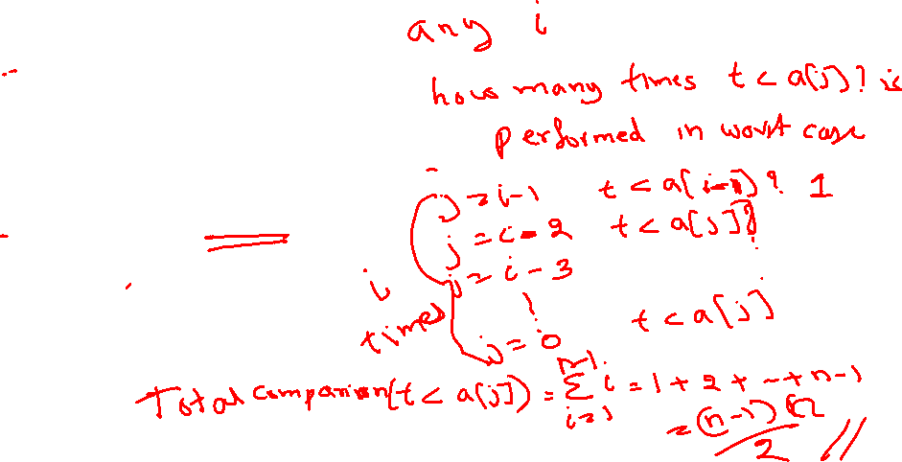
Insertion Sort
void insertionSort(int a[], int n)
{
for (int i = 1; i < n; i++)
{// insert a[i] into a[0:i-1]
int t = a[i];
for (int j = i - 1; j >= 0 && t < a[j]; j--)
a[j + 1] = a[j];
a[j + 1] = t;
}
}
i =1, j=0, 1 comparison
i=2, j = 0, 1 2 comparisons
….
…..
i = n-1, j= 0, 1,…, n-2 n-1 comparisons
Total Comparisons = 1 + 2 + …. + (n-1)
= n(n-1)/2 = O(n²)

Slide 70
Time complexity using step count method: Recursive and Non Recursive method Best, Worst and Average case time complexity

Slide 71
Time Complexity : Step Count Method
A step is a meaningful instruction of the program
A step is an amount of computing that does not depend on the instance characteristic (input size)
10 adds, 100 subtracts, 1000 multiplies can all be counted as a single step
n adds or n/2 adds, p+q addition, p-q additions cannot be counted as 1 step

Slide 72
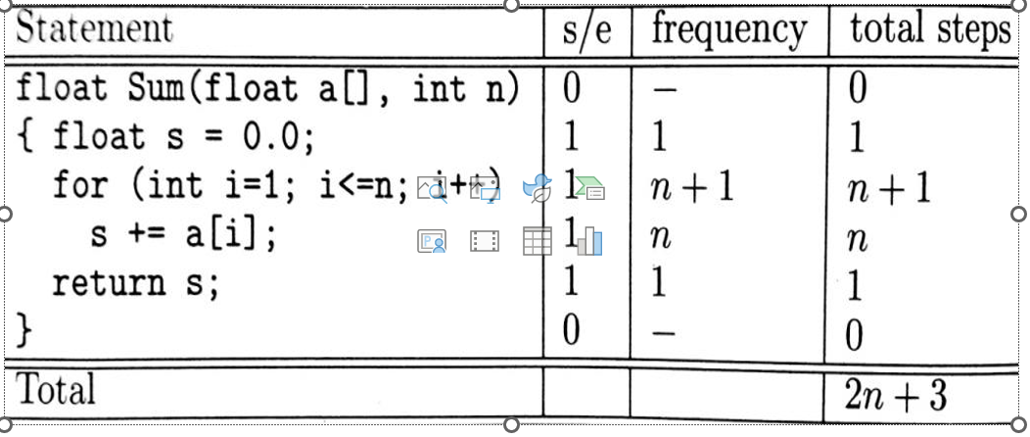

Slide 73
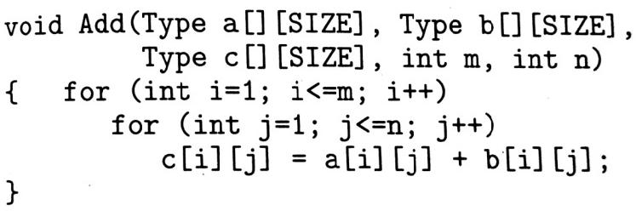
Calculate the total steps for
Calculate the Total steps for

Slide 74
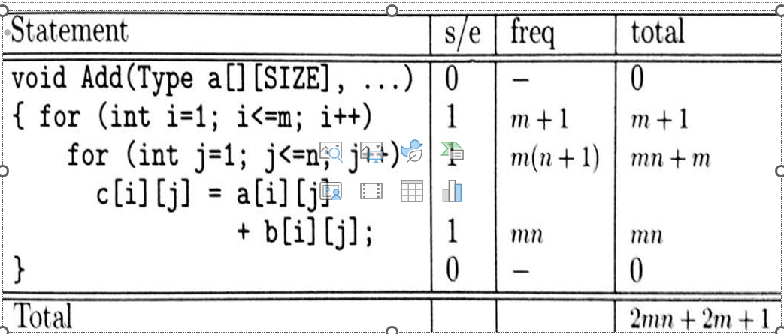

Slide 75
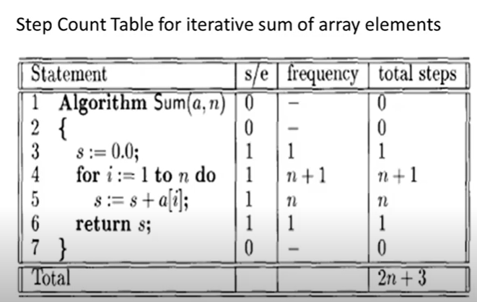

Slide 76
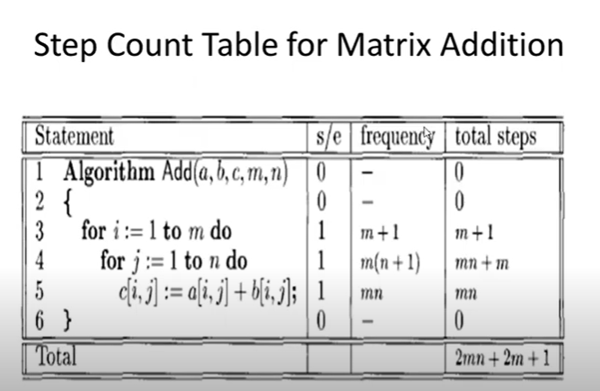

Slide 77
Time complexity: Recursive and Non Recursive method Examples for Best, Worst and Average case time complexity

Slide 78
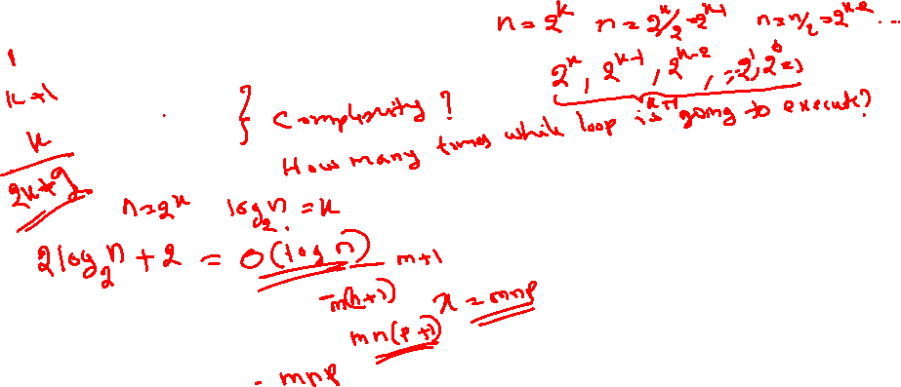
Step Count Method: Few more examples
int n; \\ assume n as power of 2
while (n>1)
n=n/2;
2. int x=0;
for(int i=0; i<m; i++)
for (int j=0; j<n; j++)
for(int k=0; k<p; k++)
x = x+1;
What is the final value of x? how many times for loop for k will execute?

Slide 79
Step Count Method: Few more examples
double n; \\ assume n =2^{k} and k as power of 2
while (n>=2)
n=sqrt(n);
int a = 0;
for (i = 0; i < N; i++) {
for (j = N; j > i; j--) {
a = a + i + j;
}
}

Slide 80
Recursive Algorithms
int rSum (int a[], int n)
{
if (n > 0)
return Rsum(a, n-1) + a[n-1];
return 0;
}
Let t_{rSum}(n) denote total step count of finding rSum(a, n). Then t_{rSum}(n) = t_{rSum}(n-1) + 2
and
Base case is t_{rSum}(0) = 2

Slide 81
Recursive Algorithms
int rSum (int a[], int n)
{
if (n > 0)
return Rsum(a, n-1) + a[n-1];
return 0;
}
Let t_{rSum}(n) denote total step count of finding rSum(a, n). Then t_{rSum}(n) = t_{rSum}(n-1) + 2
and
Base case is t_{rSum}(0) = 2
Therefore, time complexity = O(n)

Slide 82
Find the time complexity:
T(n) = T(n-1) + cn, where c is some constant and T(0)=1
For simplification take T(n) = T(n-1) + n and solve
T(n) = T(n-1) + n
= T(n-2) + 2n
= T(n -3) + 3n
------------------------------------
--------------------------------------
= T(n-n) + n²
=T(0) + n²
= O (n²) since T(0) = 1
Void Test(int n)
{
if (n > 0)
{
for (int i=0; i<n; i++)
printf(“%d”, n);
Test(n-1);
}
}

Slide 83
Find the time complexity:
T(n) = T(n-1) + c logn, where c is some constant and T(0)=1
For simplification take T(n) = T(n-1) + logn and solve
T(n) = T(n-1) + logn
= T(n-2) + logn + log (n-1)
= T(n -3) + logn + log (n-1) + log (n-2)
------------------------------------
--------------------------------------
= T(n-n) + logn + log (n-1) +… + log 1
=T(0) + log n^{n}
= O (nlog n) since T(0) = 1
Void Test(int n)
{
if (n > 0)
{
for (int i=1; i<n; i*2)
printf(“%d”, n);
Test(n-1);
}
}

Slide 84
Problems: (Homework)
T(n) = T(n – 1) + 1
T(n) = T(n – 1) + n (solved in the previous slides)
T(n) = T(n – 1) + logn (solved in the previous slides)
T(n) = T(n – 1) + n²
In all the above problem take T(0) = 1
5. Problem: What is the time complexity of recursive function for finding n factorial?

Slide 85
Recursive Algorithm Contd.
Int RSequentialSearch(int a[], int n, const int& x)
{
if ( n < 1) return -1;
if (a[n-1] == x) return n-1;
return RSquentialSearch(a n-1, x);
}
Let t_{RSequentialSearch}(n) = t_{RSequentialSearch}(n-1) + 3 and
Base case is t_{RSequentialSearch}(0) = 2
T(n) = t(n-1)+3
= [t(n-2)+3] + 3
…..
…..
= t(n-n) + 3n
= 2 + 3n = O(n)

Slide 86
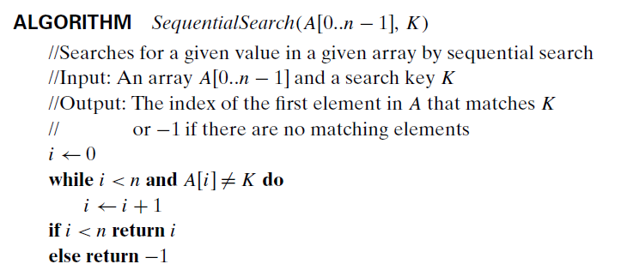
Worst-Case, Best-Case, and Average-Case Efficiencies

Slide 87
Best case for sequential search: Element found at first place.
Int SequentialSearch(int a[], int n, const int& x)
{
int i;
for (i = 0; i < n && a[i] != x; i++);
if (i == n) return -1;
else return i;
}
No. of steps

Slide 88
Worst case for sequential search: Element not found/element found at last place.
Int SequentialSearch(int a[], int n, const int& x)
{
int i;
for (i = 0; i < n && a[i] != x; i++);
if (i == n) return -1;
else return i;
}
No. of steps

Slide 89
Worst case for sequential search: element found at last place.
Int SequentialSearch(int a[], int n, const int& x)
{
int i; 1
for (i = 0; i < n && a[i] != x; i++); n
if (i == n) return -1; 1
else return i; 1
}
n+3 o(n)
No. of steps

Slide 90
Worst case for sequential search: Element not found
Int SequentialSearch(int a[], int n, const int& x)
{
int i; 1
for (i = 0; i < n && a[i] != x; i++); n+1
if (i == n) return -1; 1
else return i; 1
}
n+4 o(n)
No. of steps

Slide 91
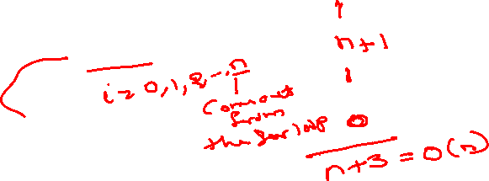
Worst case for sequential search: Element not found/element found at last place.
Int SequentialSearch(int a[], int n, const int& x)
{
int i;
for (i = 0; i < n && a[i] != x; i++);
if (i == n) return -1;
else return i;
}
No. of steps

Slide 92
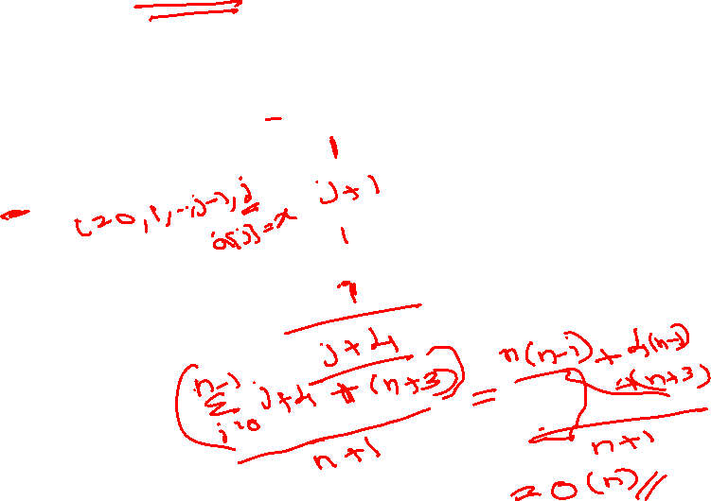
Average case for sequential search: Element found at position j. (i.e., a[j]=x)
Int SequentialSearch(int a[], int n, const int& x)
{
int i;
for (i = 0; i < n && a[i] != x; i++);
if (i == n) return -1;
else return i;
}
No. of steps
= [0 + 1 + 2 +… +(n-1) + 4 n + (n+3) ] / (n+1)

Slide 93
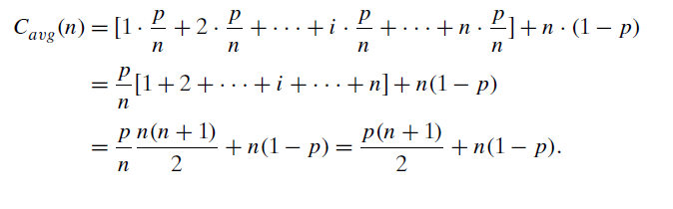
Average Case
The standard assumptions are that
(a) the probability of a successful search is equal to p (0 ≤ p ≤ 1)
(b) the probability of the first match occurring in the ith position of the list is the same for every i.
In the case of a successful search, the probability of the first match occurring in the ith position of the list is p/n for every i, and the number of comparisons made by the algorithm in such a situation is obviously i.
In the case of an unsuccessful search, the number of comparisons will be n with the probability of such a search being (1− p). Therefore,

Slide 94
Worst Case and Best Case
It guarantees that for any instance of size n, the running time will not exceed C_{worst}(n), its running time on the worst-case inputs.
The best-case inputs for sequential search are lists of size n with their first element equal to a search key; accordingly, C_{best}(n) = 1 for this algorithm.

Slide 95
What is the best, worst and average case time complexity of selection and bubble sort?
void bubbleSort(int a[], int n)
{
for (int i = n; i > 1; i--)
{
for (int j = 0; j < i - 1; j++)
{
if (a[j] > a[j+1]) swap(a[j], a[j + 1]);
}
}
}
For the given bubble sort algorithm, it takes O(n²) time for best case. But is it possible to make it O(n) for best case scenario? think the modification! What if you keep count on swaps?

Slide 96
Average Case
The standard assumptions are that
(a) the probability of a successful search is equal to p (0 ≤ p ≤ 1)
(b) the probability of the first match occurring in the ith position of the list is the same for every i.
In the case of a successful search, the probability of the first match occurring in the ith position of the list is p/n for every i, and the number of comparisons made by the algorithm in such a situation is obviously i.
In the case of an unsuccessful search, the number of comparisons will be n with the probability of such a search being (1− p). Therefore,

Slide 97

Find the asymptotic time complexity of the following
$\sum{1n i}=$
$\sum{1n i2=}$
$\sum{1n i3=}$
n!
Express using Big Oh notation.

Slide 98

Find the asymptotic time complexity of the following
$\sum{1n i}=\frac{n\left(n+1\right)}{2}$
$\sum{1n i2=\frac{n\left(n+1\right)\left(2n+1\right)}{6}}$
$\sum{1n i3=\frac{n2\left(n+1\right)2}{4}}$
n!
O(max{mn², m²n}) = O(m³) if m > n else O(n³)
.

Slide 99
Problem: What is the time complexity of recursive function for finding n factorial?

